Slide 1
Lecture 13a – Logistic Regression
Breitzman 8/14/2018

Slide 2
Basic Idea
We’ve seen a lot of classification algorithms (multiple regression, decision trees, naïve Bayes, neural networks etc.)
Logistic regression is another classification algorithm
It’s useful for binary categorical data
I.e. predicting whether a variable is true/false
Widely used for medical applications such as predicting whether a patient has a disease

Slide 3
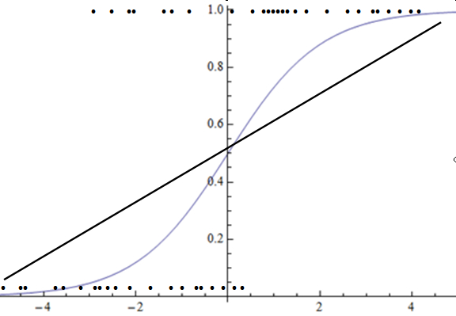
Here’s a Picture

Slide 4
What’s the Picture Mean?
True/False data make a scatter plot like on the previous page
A linear equation does a poor job of predicting such data
A logistic curve can be fit to such data in a better way

Slide 5
Mathematics Behind the Fit
Fitting a line to data is fairly straightforward via Least Squares
There is no direct way to fit a logistic curve to data
The method used is an iterative method called maximum likelihood estimation
It can be done using Newton’s method for those that learned that in Calculus
The interested reader can learn the mathematics behind it, but we’ll just use R.
There are ways to determine whether the model is good (Wald Statistics and such) but we will just hold out some testing data and use that to determine the model’s accuracy.

Slide 6
Go to R

